Slide 1

Data Science Assignment 3
Sarel Vermaak- 190980235
Isabel de Waal- 20805055
Kebaabetswe Tlhoaele- 28816749
Lize Mostert- 23537140
Difedile Rasenyalo- 28294882
Notes:
Greetings, everyone. My name is Difedile Rasenyalo, and I'm joined by Isabel, Lize,Keba and Seral. Together, we'll guide you through our presentation

Slide 2
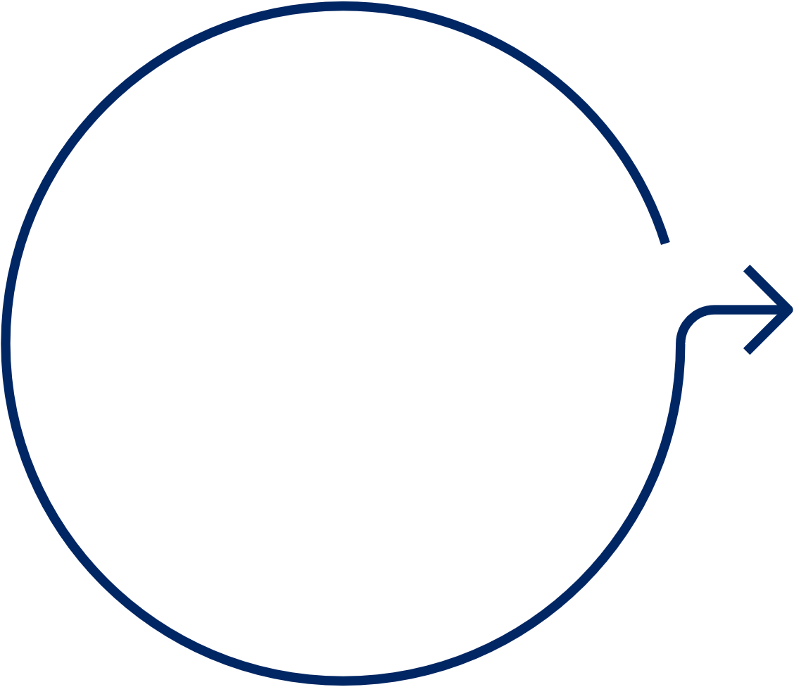





Content
1
2
3
4
5
Introduction
Methodology
Modelling
Results & Discussion
Conclusion
Notes:
We're excited to walk you through our presentation, covering the introduction, methodology, modelling, results & discussion and the conclusion.

Slide 3

Introduction
Background
"Missing data is a common challenge during data exploration and cleaning, often arising from integration errors or issues during data generation or collection. Handling missing values requires careful consideration, as simply removing them risks losing valuable information and introducing bias. Imputation emerges as a promising solution, especially when a significant portion of the data is affected.
This study investigates the impact of different imputation methods on classifier performance, focusing on mode imputation and Naïve Bayes classifier imputation. Using popular classifiers like K-nearest-neighbours and decision trees, the study evaluates the effectiveness of these imputation techniques.
Objectives
Task A: The objective was to evaluate the effectiveness of a baseline imputation versus that of a Naïve Bayes imputation on the performance of classification models. For this study we also decided to look at the influence of the proportion of missing values on the effectiveness of the imputation method. This will be done by comparing the performance of two classification models who have been trained on the control data and the imputed data and then tested with unchanged data.
Notes:
Missing data is a common challenge during data exploration and cleaning, often arising from integration errors or issues during data generation or collection. Handling missing values requires careful consideration, simply removing them risks losing valuable information and introducing bias. Imputation emerges as a promising solution, especially when a significant portion of the data is affected.
This study investigates the impact of different imputation methods on classifier performance, focusing on mode imputation and Naïve Bayes classifier imputation. Using popular classifiers like k-Nearest Neighbours (k-NN) and decision trees, the study evaluates the effectiveness of these imputation techniques.
The objective of the study is to evaluate the effectiveness of baseline imputation versus Naïve Bayes imputation on the performance of classification models. Additionally, we aim to assess the influence of the proportion of missing values on the effectiveness of the imputation method. This will be achieved by comparing the performance of two classification models trained on the control data and the imputed data, and then tested with unchanged data.

Slide 4




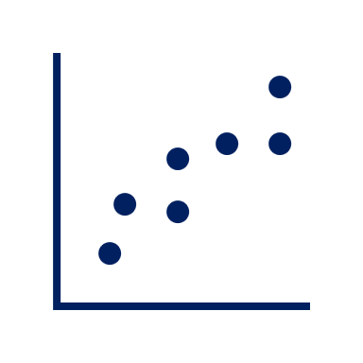


Methodology
1
Data Selection
A dataset with documented research on handling missing feature values was selected. The nursery dataset was selected in the study done by A. Farhangfara, L. Kurganb, and J. Dyc.
4
Imputation Approach
Our study employed mode imputation for categorical features, serving as a reference for comparison. Additionally, we leveraged the Naïve Bayes imputation technique to impute missing categorical features feature .
2
Data Exploration
The nursery dataset was explored to gain an understanding of its structure, variables, and content. Upon review it was observed that they was a skewed distribution of the target feature.
5
Model Comparison
The results from the K-NN and decision tree classifiers are evaluated using performance metrices including accuracy, precision, recall, F1-score.
3
6
Visualization
Line plots and bar graphs were crafted to vividly illustrate the performance disparity between the two models when trained with data imputed using distinct methods.
Data Preprocessing
The data was split into a 30:70 test: train split. Additionally, three copies of the training subset were generated and induced with missing values at varying proportions (10%, 40%, and 70%).
Notes:
I am Lize Mostert, and I will be explaining the process of how we introduced missing values to our dataset as well as the methods applied during the imputation of these missing values.
The first step was importing a clean and complete dataset that was used in the research paper we are comparing our results to. It is worth noting that during the initial data exploration, we did observe a skewed class distribution in the target feature. Following the data importation and exploration the dataset was then split into a 70:30 ratio of training to testing subsets.
I then used the training dataset and introduced missing values randomly using a loop that iterated over every feature in the dataset. The missing values were introduced in three different proportions: 10%, 40% and 70% for each feature to create three different datasets with missing values from the training dataset.
The following step involved imputing the missing values that were introduced in the previous step. Two methods were applied namely mode imputation and Naïve Bayes imputation. Because our data consisted of only categorical features, the mode of each feature was determined and used to fill in the missing values. For the Naïve Bayes imputation, I built and trained the Naïve Bayes model for each feature, and assigned the predicted values from the model to the missing values. From the imputation methods, two separate data frames were created; the mode_imputation and nb_imputation for the respective proportions of missing values.
The final step was to map the numerical values assigned to the categorical variables by the Naïve Bayes model back to the original classes for each feature and calculating the NA counts for all the data frames created to ensure that missing values were all imputed.
At the end of this process, we were left with 8 datasets. A testing set consisting of 30% of the original dataset with no missing values, a training set consisting of 70% of the original dataset with no missing values, 3 training sets imputed with the mode for 10, 40 and 70% missing values that were introduced, and 3 training sets imputed via the Naïve Bayes model for the 10, 40 and 70% missing values that were introduced.

Slide 5
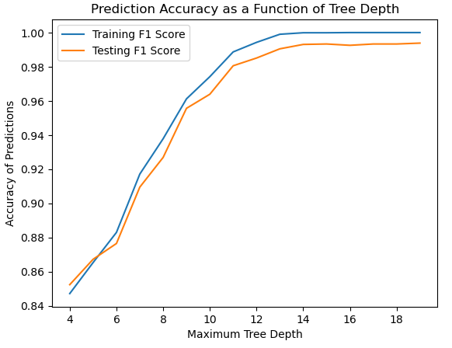
Modelling: Decision Tree Classification
Nursery Dataset
Base Train
10% missing values
40% missing values
Base Test
70% Missing Values
Naïve Bayes Imputation
Naïve Bayes Imputation
Naïve Bayes Imputation
Mode Imputation
Mode Imputation
Mode Imputation
Notes:
Hi, I am Sarel Vermaak.
Now that we have a base dataset and datasets with induced and imputed missing values, we can validate the performance of the imputation techniques by running classification models on each dataset and comparing the performance of each dataset.
I will present a decision tree classifier that was used as the first validation model.
We used the base model before missing values were induced as a control. The base dataset was split into a test and train dataset, and these were used to determine the maximum tree depth hyperparameter for the decision tree. This was done by running the model for various tree depth values, measuring the weighted F1 score across prediction classes for the training and testing set. This metric is used as a measure of error in the model, and the optimal point is there the testing F1 score either stabilizes or decreases.

Slide 6
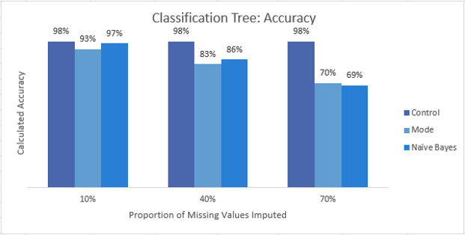
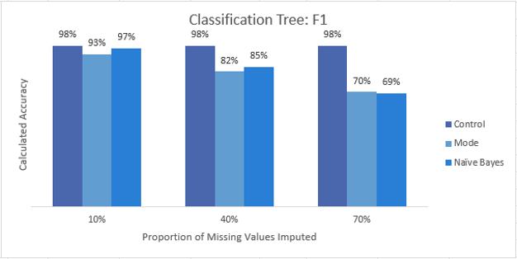
Modelling: Decision Tree Classification
Nursery Dataset
Base Train
10% missing values
40% missing values
Base Test
70% Missing Values
Naïve Bayes Imputation
Naïve Bayes Imputation
Naïve Bayes Imputation
Mode Imputation
Mode Imputation
Mode Imputation
Notes:
The model with optimal hyperparameters was then trained across the various datasets, and the accuracy and weighted F1 scores were computed for each based on predictions made against the base test table.
In this process we calculated control metrics using the base training and testing set. This base value is then compared against the mode and Naïve Bayes imputation techniques at three different levels of missing values induced on the base dataset, 10%, 40%, and 70%.
From this we can see that the classification performance declines as the number of missing values increases as expected, and surprisingly enough the Naïve Bayes and Mode imputation techniques created datasets that performed very similarly at all levels.

Slide 7



Modelling: K- Nearest Neighbours Classification
K-NN Classification
The k-Nearest Neighbors (k-NN) algorithm is a fundamental tool in supervised learning. It can handle both numeric and categorical data, making it ideal for classification problems. k-NN is simple, versatile, and easy to implement, using only one hyperparameter: the k value.
Advantages:
Simple model
Easily adaptable
It is simple, versatile and easy to implement
Uses only one hyperparameter, which is the k value and distance metric
Disadvantages:
Curse of dimensionality – K-NN finds it challenging to classify with high data set dimensionality.
Does not scale
Overfitting

Slide 8
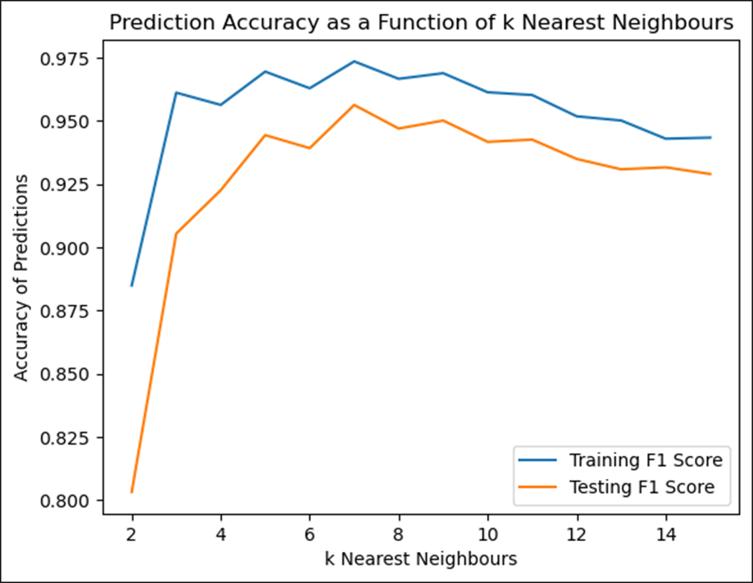
Modelling: K- Nearest Neighbours Classification
Nursery Dataset
Base Train
10% missing values
40% missing values
Base Test
70% Missing Values
Naïve Bayes Imputation
Naïve Bayes Imputation
Naïve Bayes Imputation
Mode Imputation
Mode Imputation
Mode Imputation

Slide 9
Modelling: K- Nearest Neighbours Classification
Nursery Dataset
Base Train
10% missing values
40% missing values
Base Test
70% Missing Values
Naïve Bayes Imputation
Naïve Bayes Imputation
Naïve Bayes Imputation
Mode Imputation
Mode Imputation
Mode Imputation

Slide 10

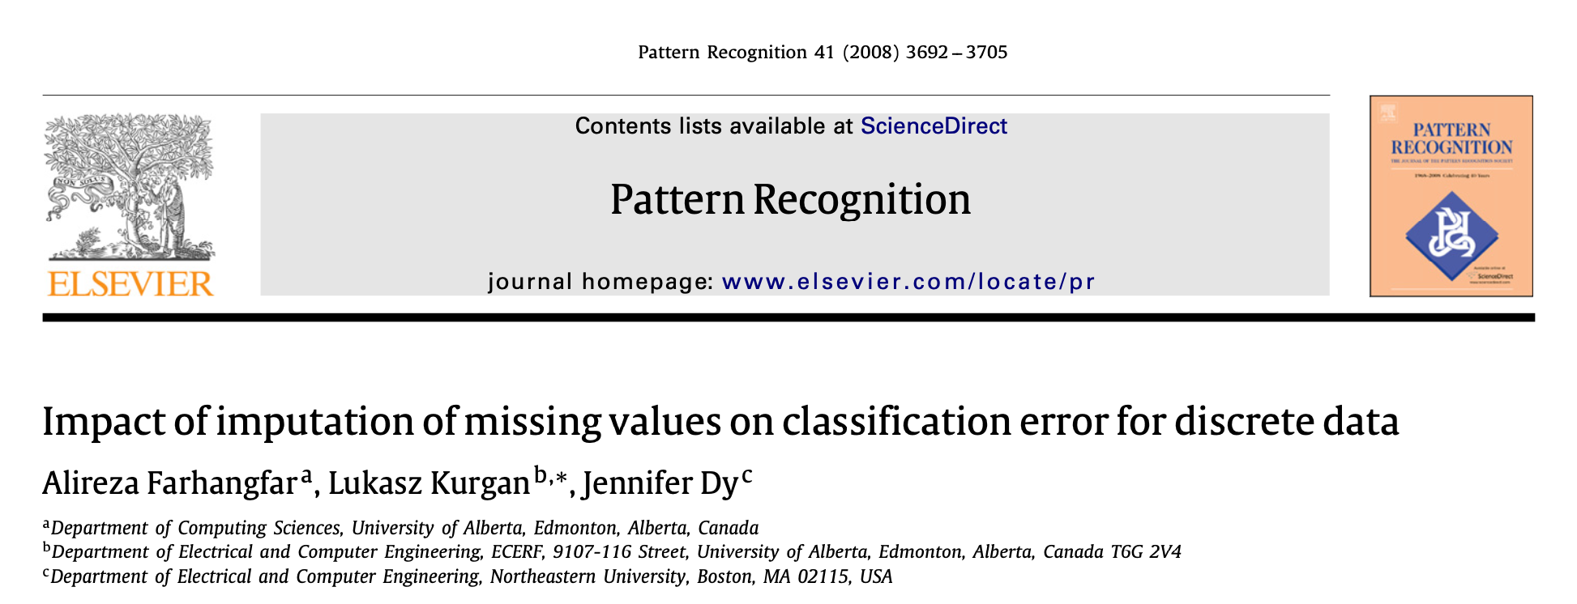
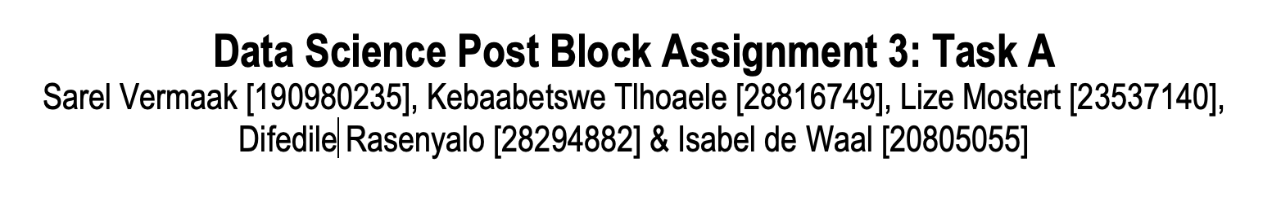
Results & Discussion
Notes:
Good day, mt name is Isabel de Waal, and I will be discussing the results Keba and Sarel just explained in context to literature.
Farhangfar et.al. conducted a similar (albeit infinitely more complex) study [3]. In it they tested 6 different imputation methods with 6 different classification models using the aggregated scores of 15 datasets (of which the ‘Nursery” dataset used in this assignment was one). As their study was much more nuanced and they used a unique way to measure model performance, direct comparisons were tricky. What was clear from their study however was that different imputation methods worked better for some models than others, and that there was no ‘universally better’ imputation method. This was also observed during this study, and supporting our findings. Of all the imputation methods in their study, the mean imputation performed the worst. For the k-NN model, we found similar results whereas we did not see this response in the classification tree model. This could simply be explained by the different methodologies used for calculating the performance. Farhangfar et.al. measured their performance by calculating the classification error which was based on a zero-one loss [3].

Slide 11

Conclusion
Notes:
In conclusion, the effectiveness of an imputation method is highly dependent on the type of model to be used. In this study it was found that the Naïve Bayes imputation suited the k-NN model better whereas the classification tree was more robust and the different imputation techniques performed about the same. In these cases, the simpler mean imputation would be recommended.
These results alighn to what was found by Farhangfar et al.

Slide 12

Thank You

